Slide 1
Power Supply
LDR
ESP8266
LED
Cloud Interface
LED
IR
LED

Slide 2
Power Supply
LDR
ESP8266
LED

Slide 3
Power Supply
ESP8266
Cloud Interface
LED

Slide 4
ESP8266
IR
LED
Power Supply

Slide 5
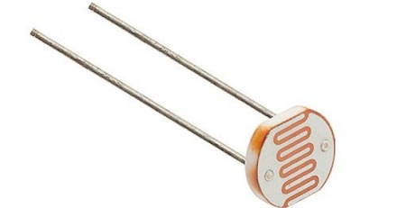
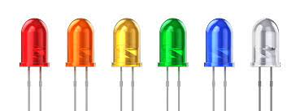
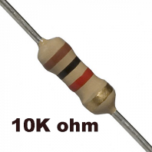
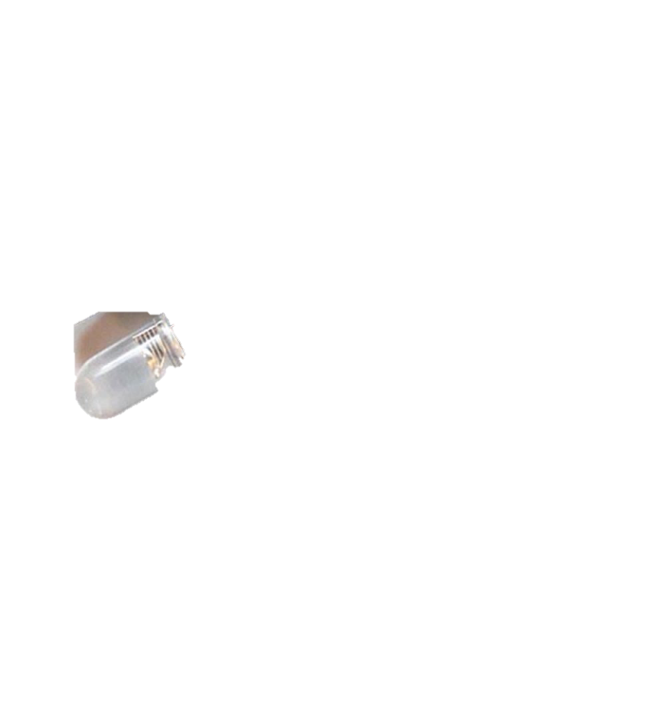
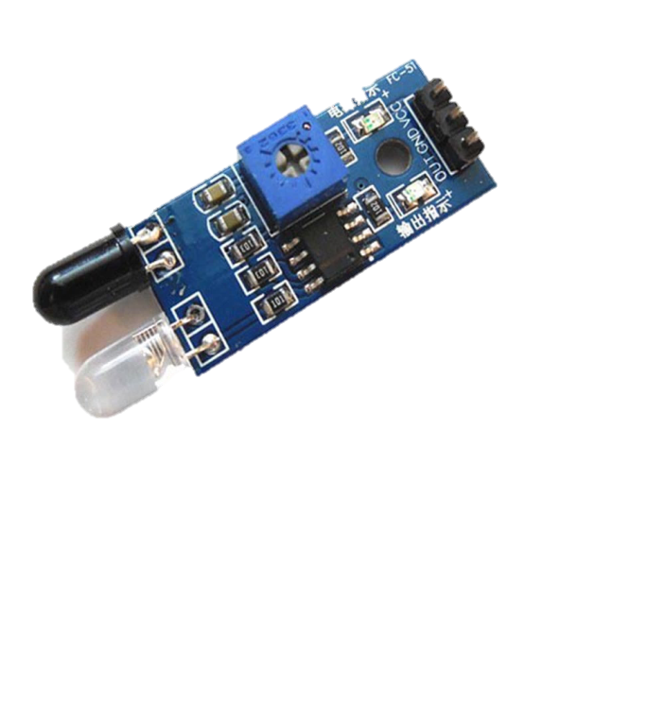
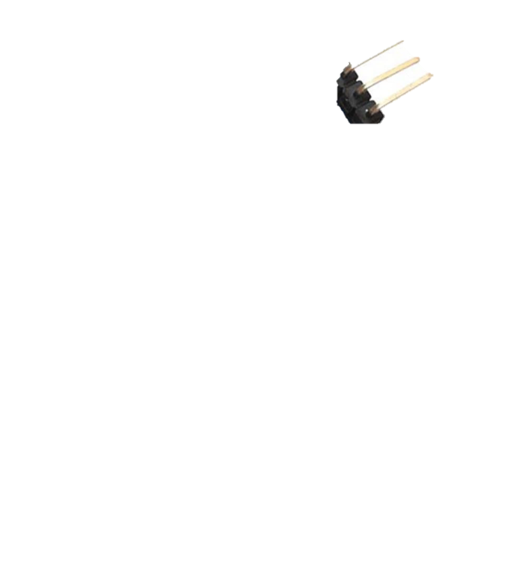
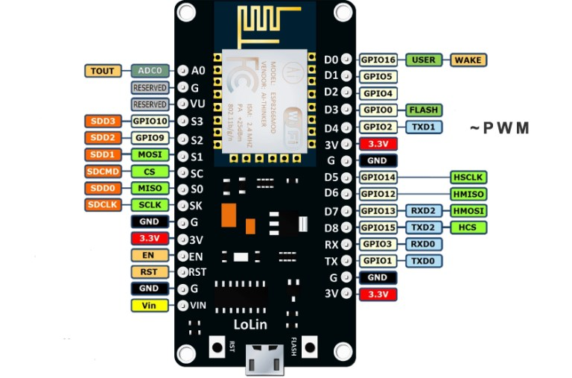

Slide 6
Hardware Requirement:
Micro Controller : ESP8266 Node MCU : 1
LDR(Light dependent resistor) : 1
LED(Light emitting Diode) : 3
IR( Infrared Sensor) : 1
Relay : 2
5V Bulb : 2
Resistor (10 ohm) : 1
Connector : 1
5V battery : 1
PCB and connecting cables
Software Requirement:
IDE : Arduino IDE
MC Programming Language : C
Interfacing : Arduino Cloud
App : Arduino IOT Remote
Additional Library: thingProperties.h

